Slide 1

Solar-Peltier Coupled Water
Purification System
Group 18
Team Members
Avinash Kumar (150169)
Atul Bimbrahw (150162)
Rahul Kumar (150546)
Undergraduate Project
Department of Mechanical Engineering
IIT Kanpur
Project Supervisor
Dr. Sameer Khandekar

Slide 2
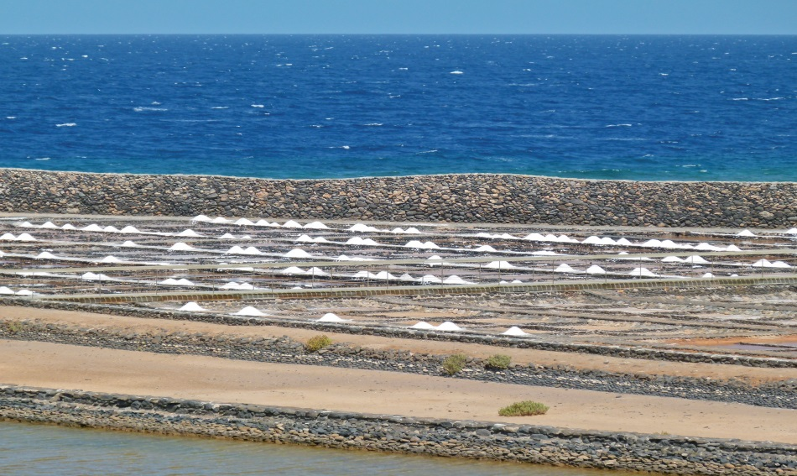
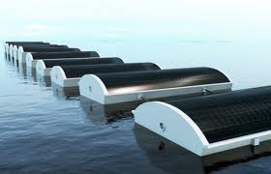
Problem Statement
Fresh Water is a major demand for human existence as it is a vital component for survival.
Of the Earth’s total surface area, only 1% contains fresh water.
In coastal areas, salinity of water is a major issue
In deserts, water obtained by rainwater harvesting is not fresh water
With a population of 7.6 billion (and increasing) demanding for fresh water, it is someday going to end.
We need a efficient solution to this problem

Slide 3
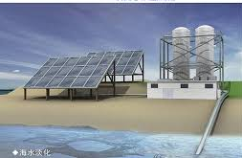

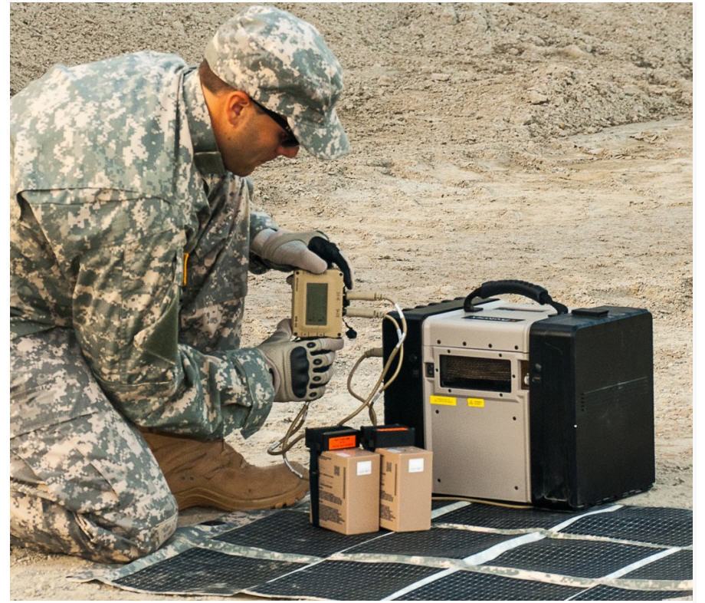
Why Solar-Peltier based purification ?
Large water purification plants are being developed/ in operation worldwide
However, for several applications, small modular plants are also needed → decentralized production
Some possible applications are: personal plants for households, defense applications, marine recreational boats, mountain expeditions, adventure trips, etc.
Peltier materials are increasingly becoming cheaper.
Solar PV is also catching up very fast on commercial levels.
We can elegantly couple these two fast emerging technologies to make pure water and package the unit as a modular system which can be scalable to larger sizes.
Specific advantages:
Uses only renewable source of energy for fresh water extraction
Economically viable for any individual or in a household
De-centralized, passive and small (integrated) in size
Less bulky and have no moving parts
Large solar desalination plants
Flexible solar panels for army
Decentralized power management for army

Slide 4


Proposed Solution
Solar PV
Porous structure over which the air will pass through
Hot
DRY air
Atmospheric Air
Peltier Element
Cold DRY air
Less hot but humid air
Impure water from different sources
condensation
Passive Humidifier
Drinkable water

Slide 5
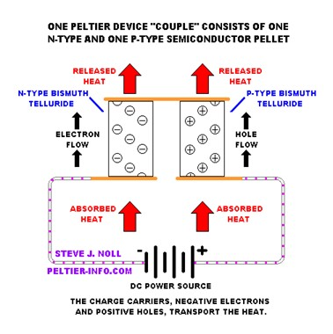
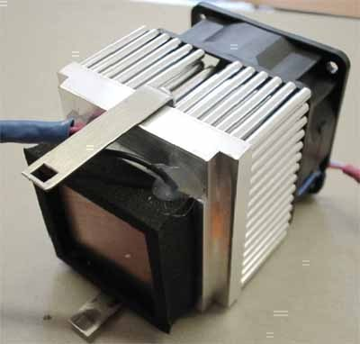
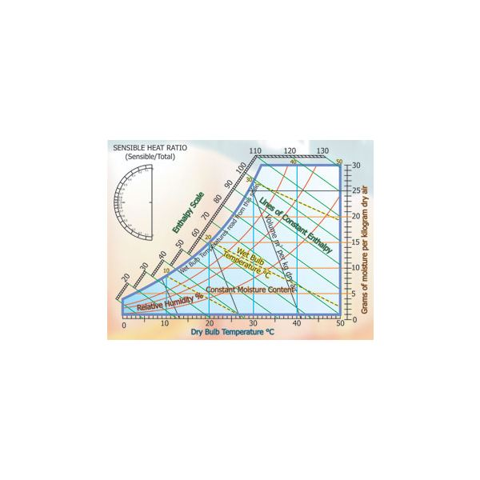
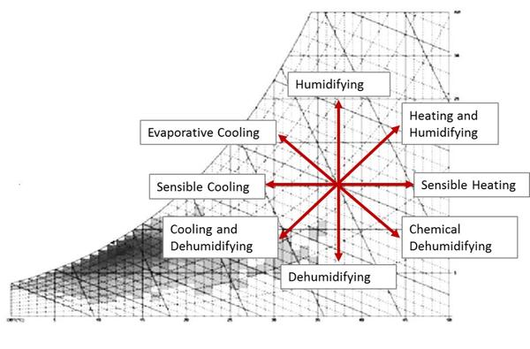
Working Principle
(i) Peltier Effect → Refrigeration design
When potential is given across the junctions of a Peltier element, it generates temperature difference and vice versa
This can be used to create a refrigerator that is compact and has no circulating fluid or moving parts.
Such refrigerators are useful in applications where their advantages outweigh the disadvantage of their very low efficiency.
(ii) Surface engineering → Hydrophobic for maximizing condensation
(iii) Psychometric and heat transfer analysis
Maximize efficiency and water production

Slide 6
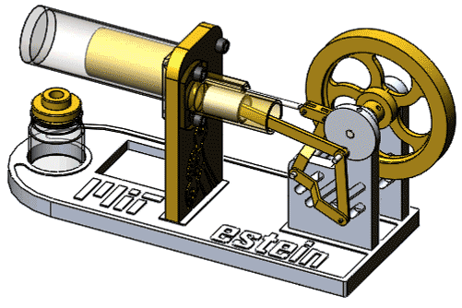
Proposal #2: The Stirling engine

